Slide 1
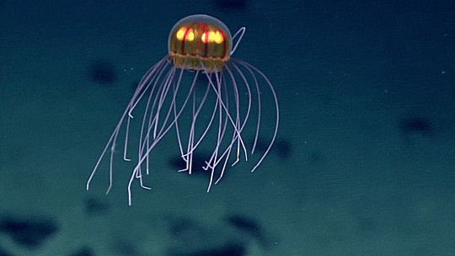
Final Research paper
Psy 280

Slide 2
Formatting overview
  Large Point Deductions:
  -5 points for failure to CHANGE ALL DISCUSSION ABOUT YOUR STUDY TO PAST TENSE!!!
  -5 points for failure to incorporate Prof’s suggested changes from Research Proposal, Paper 2A
-5 points if not in Microsoft Word
-5 points if not enough participants (i.e., 30 participants per group)
-5 points if instructions for Results section not followed
General APA Formatting
  No changes to overall formatting, except to follow any suggestions made from your Proposal Paper 2A
  Margins = 1" all sides
  Font & Size = 11-point Calibri, 11-point Arial, 10-point Lucida Sans Unicode, 12-point Times New Roman, 11-point Georgia, or 10-point Computer Modern
  COMMON MISTAKES
  Running head and page numbers not properly formatted
  Spacing = double spacing
    Make sure your entire paper is double-spaced by highlighting the entire paper and clicking "Don't add space between paragraphs of the same style" in Microsoft Word's paragraph settings.
    Spacing between sections: should it be double spaced or on a new page?
  Headings/Subheadings not properly formatted (Level 1, 2, or 3?) Refer to the Headings in APA Format source in toolbox
  In-text citations and Reference section citations incorrect
  Paragraphs = use tab indent 0.5"
    Except for Abstract
  Hanging Indents = reference section, first line flush left, the rest indented 0.5"

Slide 3
Title page
Remains unchanged in the Final Paper (assuming you made no mistakes in paper 2A)
  Title Page (page 1 of manuscript)
    Enter title, place in upper one third of page (do not start at the very top!)
      Recommended length = no more than 12 words
      Cap first letter of each word in title (called "title case")
    Next line, Include author’s name in format = first, middle initial, last
    Then on separate lines include: the course number/name, instructor name, and assignment due date
    Running head = abbreviated version of your main title, top of every page, no more than 50 characters (incl spaces)
  COMMON MISTAKES
    Page numbers: flush right and on the same line as the running head
    Running head: ALL CAPS and flush left
    Starting the main title at the very top of the page
    See Example APA Format Research Paper 7th Edition w Notes on the Toolbox page

Slide 4

Learning Check #1
In APA style, a separate title page is required for a document.
True
False

Slide 5
Learning Check #2
What is a running head in APA style?
a header included at the top of the page containing the author's name and the page number
an abbreviated form of the title, up to 50 characters long, in all uppercase letters at the top of each page

Slide 6
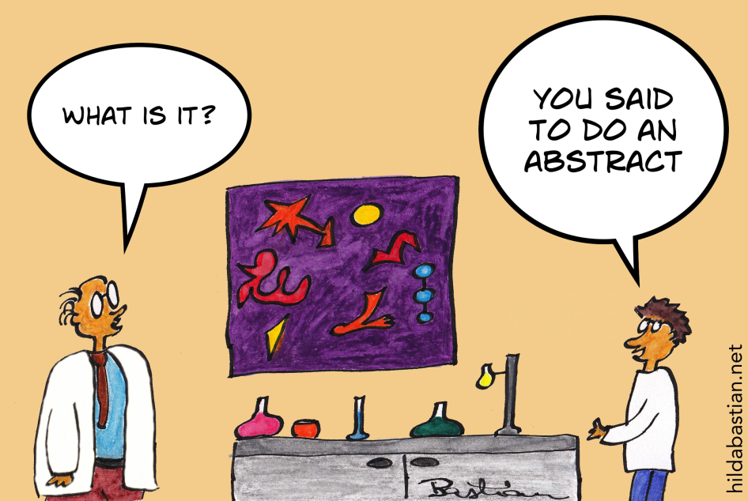
Abstract
CHANGE DISCUSSIONS OF YOUR RESEARCH TO PAST VERB TENSE!
Change the research hypothesis to, “It was hypothesized that…”
Indicate results (whether hypothesis was supported)
The rest remains virtually unchanged
  ≤ 250 words
  Brief summary of entire paper
  Center and bold the word “Abstract"
  Write a single paragraph
COMMON MISTAKES
  Do NOT indent paragraph
  Verb tense incorrect

Slide 7
Introduction
CHANGE DESCRIPTION OF YOUR STUDY IN THE LAST PARAGRAPH OR ELSEWHERE TO PAST TENSE!
This section remains virtually unchanged!
  Unless you want to make improvements ☺
COMMON MISTAKES
  A shortened version of your title starts this section.
  Title should not be called “Introduction”
  At least 3 peer reviewed articles and 1 alternative source required
  In-text citations
    In-text citations should include only the last name of the author, the date, and a pager number if you directly quote the source.
    See the class website Toolbox for the In-text Citations Short Guide for examples
In-Text Citation Examples:
(Nichols, 2017)
Nichols (2017) argued …
In 2017, Nichols argued …
Direct Quotes:
“The average citizen is wary of expert advice” (Nichols, 2017, p. 23).
Nichols (2017) argued that “the average citizen is wary of expert advice” (p. 23).
Two Authors:
Hospitalized patients reported improvements to mood following pet therapy visits (Coakley & Mahoney, 2009).
Coakley and Mahoney (2009) found that hospitalized patients reported improvements to mood following pet therapy visits.
Three or More Authors:
(Adams et al., 2014)
Adams et al. (2014)

Slide 8
Learning check #3
What would an in-text citation include when the author of a source is unknown?
the word anonymous and the year of publication
the first few words of the Reference list entry (i.e. part of the title) and the publication year
A or B depending on if the author is unknown or identified as anonymous

Slide 9
Learning Check #4
What does an APA in-text citation include in parentheses when the source is quoted directly and the author's name is not mentioned in the text?
Author, publication year, and page number (preceded by p.) without intervening punctuation: (Doe 2017 p. 25)
Author and page number separated by a comma: (Doe, 25)
Author, publication year, and page number (preceded by p.) all separated by commas: (Doe, 2017, p. 25)
Author and page number without intervening punctuation: (Doe 25)

Slide 10
Method: Participants
CHANGE TO PAST TENSE!
Indicate number of participants you ended up obtaining for your study.
  Use numbers to report age ranges. Do not spell them out.
Describe your sample: number of males and females? Ethnic groups? Education? Etc.? (Demographics)
Where did you obtain your sample?
Were there any incentives to participate?
Anything relevant, unusual events happen, or difficulties encountered?
  How did you deal with them?
COMMON MISTAKES
  Failing to update
  Changing to past tense
  Do NOT start this section on a new page
    Use only double space after the Introduction section.
  Improper format for subheadings

Slide 11
Method: materials
CHANGE TO PAST TENSE!
Unless you did not follow what you purposed in your research proposal, this section remains virtually unchanged
Provide examples of questions from your survey(s) or put an example of your survey(s), in an Appendix.
COMMON MISTAKES
  Changing to past tense
  Not describing materials well (e.g., surveys, websites, apparatuses, apps, etc.)
  Not providing examples of questions in surveys, websites, etc.
    Providing a picture (i.e., figures) or example surveys in an Appendix may be a good idea. Use the resources in the Toolbox to properly format Appendices, Tables, and Figures within the APA Format Resources dropdown.
    If your survey was created by someone else, cite it!

Slide 12
Materials: procedure
CHANGE TO PAST TENSE!
Very little should change in this section unless you deviated from what you stated in your proposal
Describe anything that happened that was not stated in the proposal
Describe any difficulties encountered and what was done to remediate them
COMMON MISTAKES
  Failing to update
  Changing to past tense

Slide 13
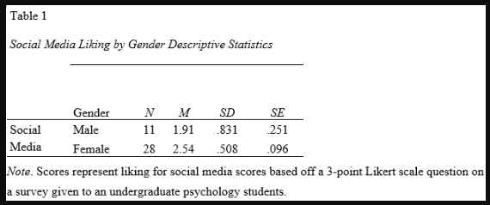
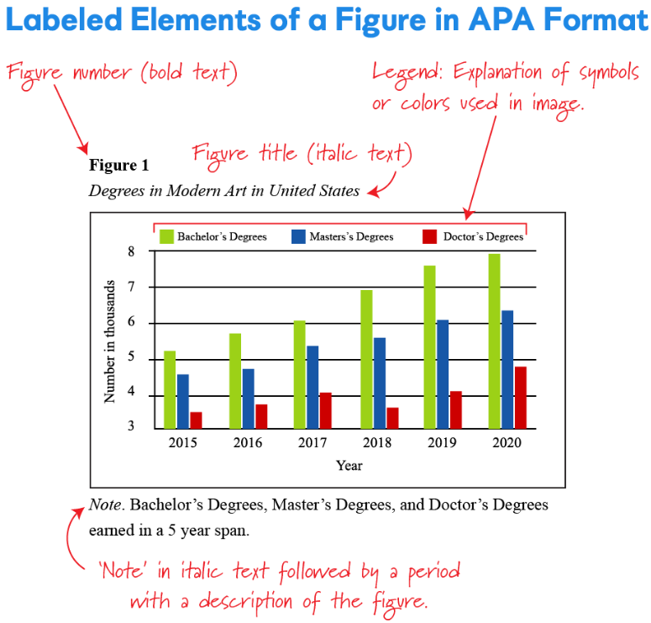
Statistics to Results section
This section becomes your Results section for your final paper
  Change “Statistics” to “Results” center and bold
  It does NOT start on a new page.
    Use only double space after the Method section.
  Comes before Discussion section
Refer to Statistics webpage for short instructional videos to perform your analyses
See the “Results Section-Quick Guide” for Results section instructions
Use example sentences from the “Reporting Statistics in Psychology Guide” for correct APA format.
Add charts and graphs (especially for the hypothesis test)
COMMON MISTAKES
  Incorrect APA Format
  Do NOT start on a new page
  Not using Level 1 Heading

Slide 14
Learning Check #5
Which of the following is cited correctly in APA style?
Dietel and Dietel define pointers as "variables that contain as their values addresses of other variables." (1999, p. 294)
Dietel and Dietel (1999) define pointers as "variables that contain as their values addresses of other variables" (p. 294).
Dietel and Dietel (C How to Program) define pointers as "variables that contain as their values addresses of other variables" (p. 294).

Slide 15
Learning Check #6
In APA style, a long quotation more than 40 words long should be
... single-spaced and indented half an inch
... double-spaced, indented half an inch, and have no quotation marks
... single-spaced, indented half an inch, and enclosed in single quotation marks
... enclosed in double quotation marks

Slide 16
Possible outcomes to Discussion Section
This section becomes your Discussion section for your final paper
Reflect on the results of your study and interpret your findings in relation to your initial expectations.
  How do your findings relate to what you included about the readings in your Introduction section?
  Discuss if hypothesis was supported/not supported
  Give some reasons why each might happen, the implications associated with both scenarios, and offer alternative explanations if your hypothesis is not supported.
Provide possible weaknesses and strengths associated with your study.
  Refer to the course text/lecture
  Think of some of the advantages and disadvantages that we've covered in the lecture/text for different types of study designs and sampling techniques and discuss them here.
Discuss ideas for future research
  This is where you aim to get noticed in the research community and try to convince others to add to your research.
COMMON MISTAKES
  Failing to make appropriate changes based on completed research

Slide 17
References
You should have at least 3 peer reviewed articles and 1 alternative source
See “APA Format Resources” dropdown on the Toolbox webpage for APA References section resources
  Starts on new page
  Title, “References,” is centered and bold
  Hanging indent
  Double spaced, 1-inch margins
  Alphabetical Order
  Author’s last name comes first, followed by a comma and the initials. Leave a space between initials.
  Place the year in parentheses. End with a period.
  Put article titles in sentence case. End with a period.
  Put journal titles in title case and italicize. End with a comma.
  Italicize volume number
  Place issue numbers within parenthesis. End with a comma.
  Add page range. End with a period.
  Include doi (digital object identifiers).
    Can usually be found on the articles, by Googling them, or in library database.
COMMON MISTAKES
  All of the above

Slide 18
7th Edition
Quick Reference Guide
Invert names so that the last name comes first, followed by a comma and the initials. Leave a space between initials. Retain the order of authors’ names.
Place the year in parentheses.
End with a period.
Capitalize only the first letter of the first word. For a two-part title, capitalize the first word of the second part of the title. Also capitalize proper nouns. Do not italicize. End with a period.
Journal Article
Author, A. A., & Author, B. B.
(Year).
Title of the article.
Name of the Periodical,
volume
(issue),
#–#.
https://doi.org/xxxx
Capitalize all major words in the periodical name. Follow with a comma. Italicize the periodical name (but not the comma after).
Italicize the volume number. Do not put a space between the volume number and the parentheses around the issue number.
Do not italicize the issue number or parentheses. Follow the parentheses with a comma. No issue number? That’s okay. Follow the volume number with a comma.
Include the article page range. Use an en dash; do not put spaces around the en dash. End with a period.
Does the article have a DOI? Include a DOI for all works that have one. Do not put a period after the DOI.
Invert names so that the last name comes first, followed by a comma and the initials. Leave a space between initials. Retain the order of authors’ names.
Place the copyright year in parentheses. End with a period.
Capitalize only the first letter of the first word. For a two-part title, capitalize the first word of the second part of the title. Also capitalize proper nouns. Italicize the title. End with a period.
Author, A. A., & Author, B. B.
(Copyright Year).
Title of the book .
(7th ed.)
Book
Publisher.
DOI or URL
Include the name of the publisher, followed by a period. Do not include the publisher location. Are there multiple publishers?
If so, separate them with a semicolon.
Does the book have a DOI? Include a DOI if available.
Do not include a URL or database information for works from academic research databases. Include a URL for ebooks from other websites. Do not put a period after the DOI or URL.
Does the book have an edition or volume number? If so, include the number in parentheses after the title but before the period. If both, show edition first and volume second, separated by a comma. Do not put a period between the title and the parenthetical information.

Slide 19
Invert names so that the last name comes first, followed by a comma and the initials. Leave a space between initials. Retain the order of authors’ names.
Place the copyright year in parentheses. End with a period.
Capitalize only the first letter of the first word. For a two-part title, capitalize the first word of the second part of the title.
Also capitalize proper nouns. Do not italicize. End with a period.
Author, A. A., & Author, B. B.
(Copyright Year). Title of the book chapter.
Chapter in
an Edited Book
In A. A. Editor & B. B. Editor (Eds.),
Title of the book (2nd ed., pp. #–#).
Publisher.
DOI or URL
Provide the title of the book in which the chapter appears. Capitalize only the first letter of the first word. For a two-part title, capitalize the first word of the second part of the title. Also capitalize proper nouns. Italicize the book title.
Include the chapter page range. End with a period. Does the book have an edition or volume number? If so, include the number in parentheses before the page range. If both, show edition
first and volume second, separated by a comma, before the page range. Do not put a period between the title and the parenthetical information.
Write the word “In” and the initials and last name (not inverted) of each editor. Use “(Ed.)” for one editor or “(Eds.)” for multiple editors. End with a comma.
Include the name of the publisher followed by a period. Do not include the publisher location. If there are multiple publishers, separate them with a semicolon.
Does the book have a DOI or URL? Include a DOI if available. Do not include a URL or database information for works from academic research databases. Include a URL for ebooks from other websites. Do not put a period after the DOI or URL.
More information on reference variations not shown here (e.g., in-press articles, articles with article numbers, articles without DOIs, books with titled volumes, audiobooks) can be found in the Publication Manual of the American Psychological Association (7th ed.) and in the Concise Guide to APA Style (7th ed.):
SOURCE: American Psychological Association. (2020). Publication manual of the American Psychological Association (7th ed.). https://doi.org/10.1037/0000165-000
CREDIT: MELANIE R. FOWLER, FLORIDA SOUTHERN COLLEGE
Journal articles and other periodicals Books and reference works
Edited book chapters and entries in reference works
Section 10.1
Section 10.2
Section 10.3

Slide 20
Learning Check #7
Each source listed in the Reference list must be cited in text
True
False

