Slide 1
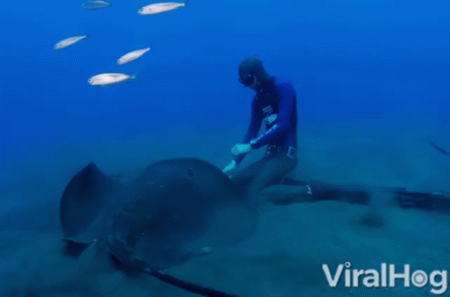
Writing a Research proposal/Final
APA Format paper

Slide 2
Ai not allowed
Papers are Submitted using TURN IT IN.
AI use will receive a zero.
TURN IT IN Can Detect AI.
AI is NOT ALLOWED for writing, editing, or summarizing text, or for analyzing data.
Be sure to cite sources used so that they are not mistaken for AI or plagiarism.
Papers evaluated by Grammarly will often be detected as AI by Turn It In.
Appropriate Use
AI can assist, not replace, critical thinking, evaluation, or project conceptualization.
AI use should be disclosed and cited if it contributes significantly to project ideas.
Accountability: As a user, you are responsible for verifying:
Accuracy of information
Proper sourcing and references

Slide 3
Impacts on ACADEMIC PERFORMANCE
Reductions in critical thinking and cognition
  Encourages cognitive laziness
  Diminishes problem-solving abilities
  Memory retention decline
    You cannot recall information that your brain does not retain. ~ Sousa
Increases trust and dependency on AI tools
  Produces papers with hallucinations, fake sources, and are factually incorrect
Studies have found
Strikingly lower GPA overall at end of classes where AI use was problematic
Students who used AI took much more time to learn much less and took that time from other students who wanted to build on their own thinking
Students had a lack of Imagination & Boring Work:
  Papers with common regurgitation of common ideas from ChatGPT—drinking water from a common, unfiltered lake—no novel ideas or exploration

Slide 4
Potential Severe Consequences
Ph.D Student Yang was expelled from the University of Minnesota for a second incident when a panel unanimously found him responsible. He is suing. He said he used Chat GPT to help him file those lawsuits. https://youtu.be/MNonKtRrw7Q?si=hfdz-8dQNDdsJYTm
University of North Georgie student Marely Stevens used Grammarly and was found responsible for inappropriate use, lost her scholarship, her GPA went down, and she was put on academic probation. Grammarly donated $4,000.00 to her GoFundMe. USA Today, byline Rachel Hale, Jan 22, 2025
During hiring interviews, applicants are frequently using AI on their phones to answer questions, called “interview fraud.” This is a growing issue. The Atlantic, Ian Bogost, Oct 15, 2025
Attorney Zachariah Crabill, used Chat GPT when he felt his workload was too heavy. Chat GPT saved him “hours of work.” His motion was filed with a Colorado Court, but it was filled with fake lawsuit citations. The judge reported him to the statewide bar. He was fired. Business Insider, Aaron Mok, Nov. 17, 2023.
Attorney Amir Mostafavi was fined $10,000.00 for filing an appeal when it was discovered that 21 out of the 23 quotes in his opening brief were fake. Calmatters, Hari Johnson, Sept. 22, 2025
Attorney Richard Bednar was sanctioned after he filed a brief with false citations. He had to pay the respondent attorney fees, refund fees to his own client, and donate $1,000.00 to a non-profit. The Guardian, May 31, 2025

Slide 5
Proposal Paper vs final paper
Class Papers:
APA Format Paper #1 = A Final Research Paper
  The Stroop Experiment
  Purpose: Dry Run/Practice for Writing an APA Format Paper
    It is a shortened version of the research process.
    Proposal Process is bypassed
APA Format Papers #2A & 2B
  Based upon your group’s research project
  Encompasses the full experimental research process
    APA Format Paper #2A = A Research Proposal Paper
    APA Format Paper #2B = A Final Research Paper
Please note the differences between a Research Proposal Paper and a Final Research Paper throughout these instructions
RESEARCH PROPOSAL PAPERS are written to propose research that a researcher wishes to conduct in the future.
After the research is conducted, RESEARCH PROPOSAL PAPERS become FINAL RESEARCH PAPERS, which report on the results of your research.
Because we are conducting the Stroop Experiment together in class, we are bypassing writing the Research Proposal Paper, and we will write a FINAL RESEARCH PAPER
TYPICAL RESEARCH PROCESS
Brainstorming for Research Ideas & Investigating the Literature
Write & Submit Research Proposal (APA Paper #2A)
Conduct Research
Write Final Research Report (APA Paper #2B)

Slide 6
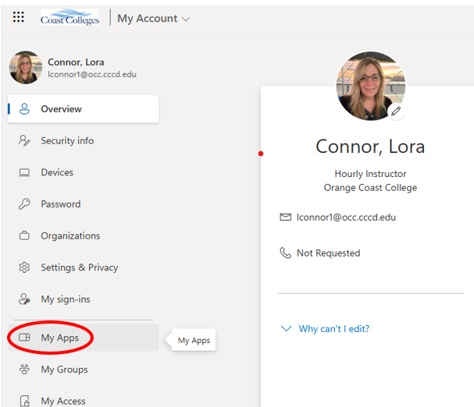
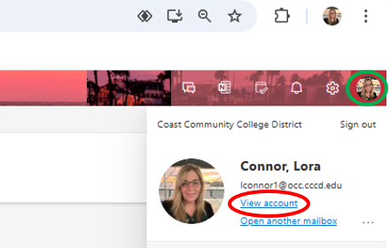
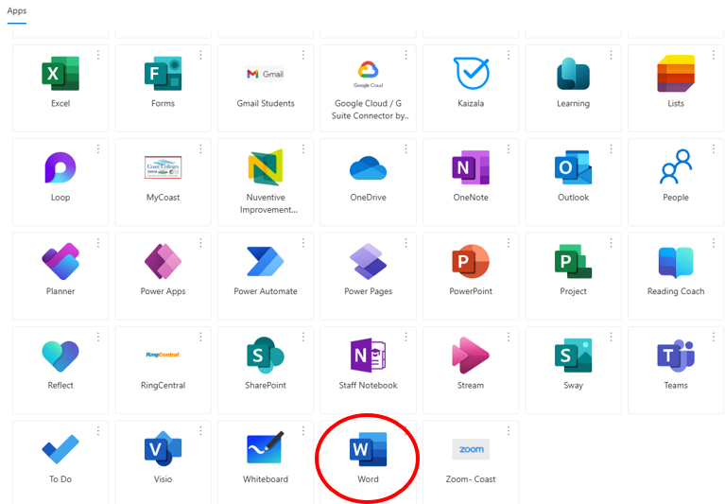
Microsoft Word
Papers MUST be written using MS Word! Papers submitted in PDF, Google docs, or other formats will be docked 5 points.
Download Office 365 and sign in using your school login credentials.
Or access Office 365 using your school account.
Navigate to your school email and click your account icon to “View account.”
Select “My Apps” and find MS Word.

Slide 7
Formatting overview
See example papers on Toolbox Webpage on class website within the “APA Paper & Group Research Project Instructions” dropdown.
APA Formatting
Margins = 1" all sides
Font & Size = While the APA Manual does not specify a single font or set of fonts, it does recommend a few fonts that are widely available:
  11-point Calibri
  11-point Arial
  10-point Lucida Sans Unicode
  12-point Times New Roman
  11-point Georgia
  10-point Computer Modern
Whichever font is chosen, that font/size should be used throughout the report

Slide 8
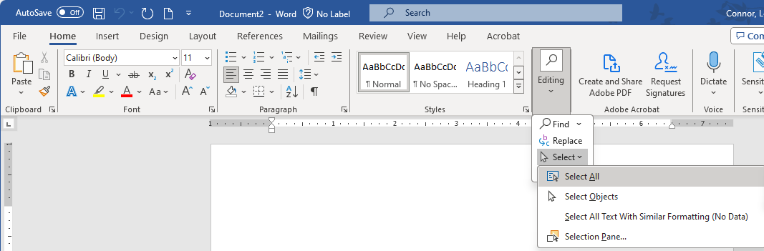
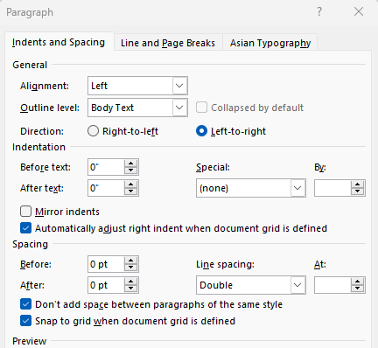
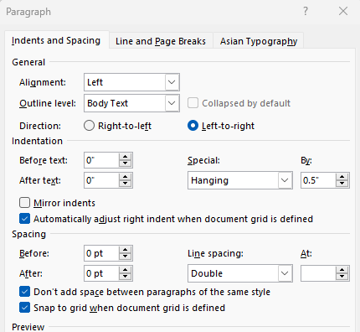
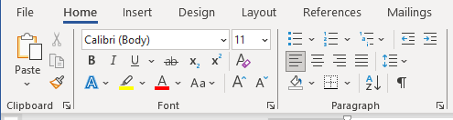
Formatting overview Continued
Text alignment = flush left
Spacing = double spacing throughout
  See Steps 1 – 3 below for double spacing settings in MS Word.
Paragraphs = use tab indent 0.5"
  Except for Abstract
  Use Hanging Indents in Reference section: first line flush left, rest indented 0.5" (see below)
Step 1. Double Spacing
Step 3. Double Spacing
Hanging Indents
Step 2. Double Spacing

Slide 9
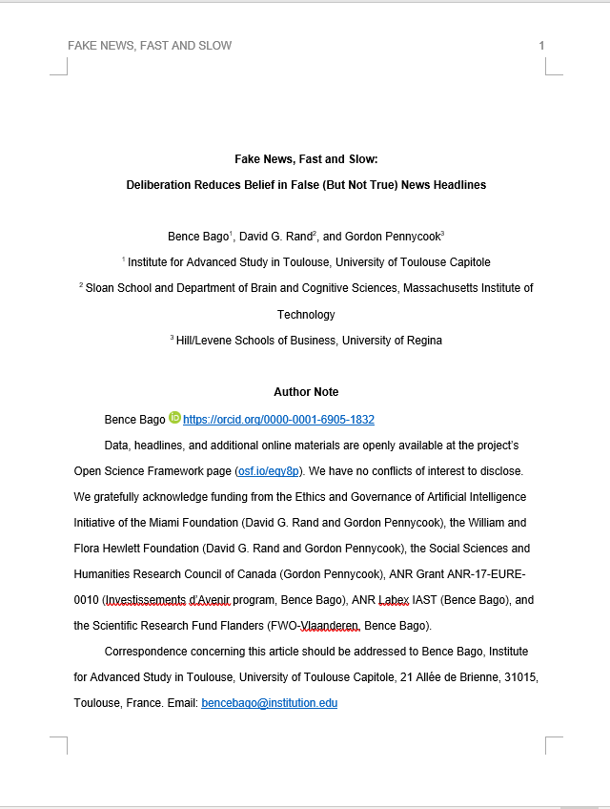
Title
Recommended length = no more than 12 words
Title Page (page 1 of manuscript)
Running head on Title Page includes:
  Abbreviated version of main title
  flush left and page # flush right
  All caps, top of every page, no more than 50 characters (incl spaces)
Place title in upper third of page
Use Bold Font and Cap First Letter Of Each Word In Title (called "Title Case")
Include author’s name in format = first, middle initial, last
Next line state institutional affiliations of author
A student paper should also include the course number and name, instructor name, and assignment due date.
TITLE PAGE (Page 1)
Running head appears on all pages. Flush left in all caps. No more than 50 char
Page numbers on all pages. Flush right.
Title in Title case, centered, boldface in the upper half of the page on no more than two lines.
Each author with first name, middle initial(s), and last name. Do not use titles (Dr.) or degrees (PhD). Are listed with institution affiliation.
Author’s note in professional papers. Not required for student papers.
TIP: Formatting is much easier if you insert a page break.

Slide 10

Learning Check #1
What line spacing should you use for all text in an APA Style paper?
Single
Double

Slide 11
Learning Check #2
Where do the page numbers go in an APA Style paper (including the title page)?
Bottom left
Top right
Bottom right

Slide 12
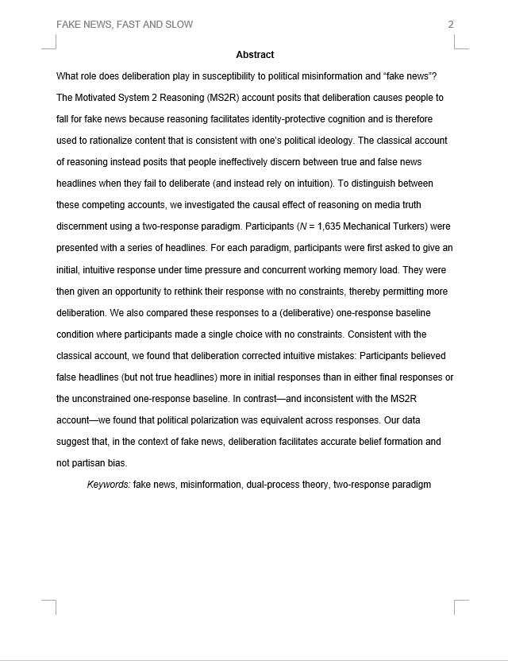
Abstract
NO MORE than 250 words
Brief summary of entire paper
Center and boldface the level 1 heading: Abstract
Write a single paragraph, no indents
Clearly state the research hypothesis, “It is hypothesized that…”
  Be sure to indicate the direction of the expected results.
  For example, what variable will increase/decrease in relation to another variable that increases/decreases.
    It is hypothesized that individuals who have strong study skills compared to those with weak study skills, as assessed with the Study Skills Questionnaire, will have higher exam scores.
For RESEARCH PROPOSALS: Content related to your study in the abstract should be stated in future verb tense
  The study HAS NOT BEEN conducted yet. You are purposing to do research in the future.
For FINAL PAPERS: Content related to your study in the abstract should be stated in past verb tense
  The study HAS BEEN conducted, and you are reporting on what happened in the past
Title “Abstract” Centered and Boldfaced
Do NOT indent.
1-inch margins, double spaced, and no more than 250 words.
Future Verb Tense
Research Proposals
Past Verb Tense
Final Papers
APA Paper #1: Stroop Effect Experiment
APA Research Proposal Paper #2A
APA Research Proposal Paper #2B

Slide 13
Introduction
APA format: starts with the title of the paper and no more than two lines long.(1st level heading, centered and boldface font)
  Start intro with abbreviated or full title of the paper, Do NOT Name it “Introduction!”
  Reviews the research others have done on the same topic
  Provides justification (argument) for why the study needs to be done
  Is there any psychological theory that you can add to support your arguments for this research?
PAPER REQUIRMENTS
APA Paper #1: Stroop Effect Experiment:
  At least three paragraphs
  Has intro & closing paragraphs and one paragraph to review your source (i.e., Stroop, 1935, source is provided for you on class website)
APA PAPERS #2A & #2B: Group Research papers (Done Individually):
  Has intro & closing paragraphs and one paragraph for each source.
  Must have at least 3 peer-reviewed articles and 1 alternative or news source

Slide 14
Introduction Cont.
First paragraph: should be catchy and pique the reader’s interest
Middle paragraph(s): should describe each source
  Summarize how their research was conducted and their research outcomes
  Explain how their outcomes relate to your research
Last paragraph: summarize your study and explicitly restate your hypothesis
  “It is hypothesized that…” (It’s okay to copy-paste from Abstract)
  Optional:
    Consider using the subtitle “Present Study” for this paragraph (2nd level heading)

Slide 15
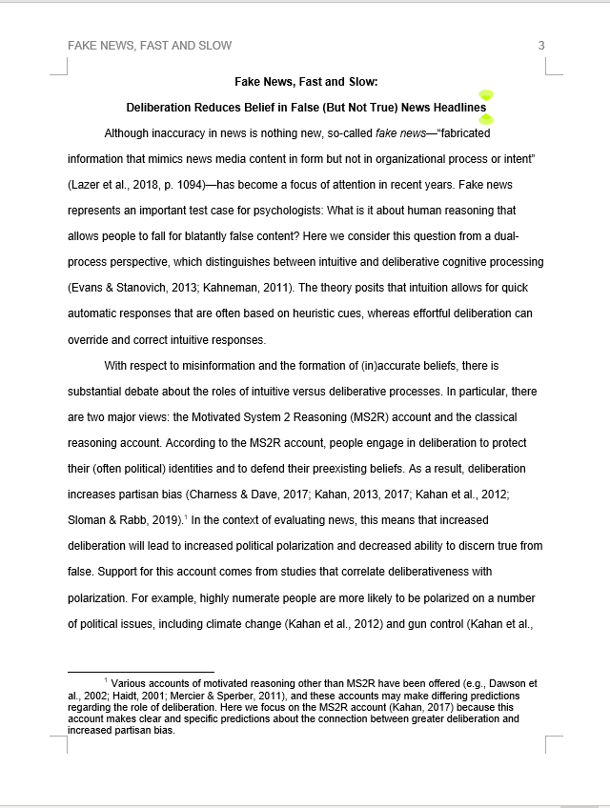
Running head
1st level heading, centered, and in boldface (See APA Manual for heading levels)
APA Headings
Level | Format
1 | Centered, Boldface, Uppercase and Lowercase Headings
2 | Left-aligned, Boldface, Uppercase and Lowercase Heading
3 | Indented, boldface, lowercase heading with a period. Begin body text after the period.
4 | Indented, boldface, italicized, lowercase heading with a period. Begin body text after the period.
5 | Indented, italicized, lowercase heading with a period. Begin body text after the period.
Indent all paragraphs

Slide 16
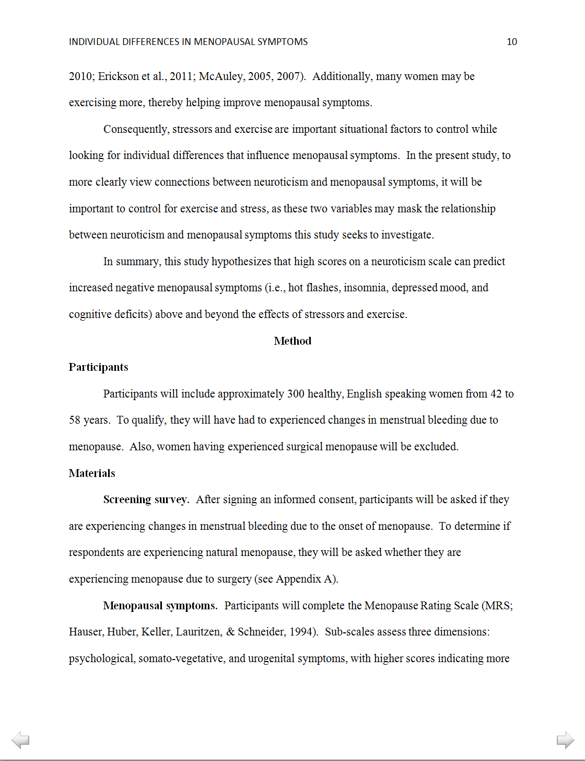
Introduction
(last Paragraph)
Last paragraph may:
  include summary (if intro is lengthy)
  Concluding sentence
  Formal statement of thesis statement with hypothesis(es)
Last paragraph states hypothesis and directionality of variables.
1st level heading, centered, and in boldface. No more than double-space between sections and subtitles.
2nd level heading, Left-aligned, Boldface, Uppercase and Lowercase Heading

Slide 17
  In-text Citations:
  Supporting evidence in the
  Introduction
Direct Quotes must have page numbers:
  According to Palladino and Wade (2010), “a flexible mind is a healthy mind” (p. 147).
  In 2010, Palladino and Wade noted that “a flexible mind is a healthy mind” (p. 147).
  In fact, “a flexible mind is a healthy mind” (Palladino & Wade, 2010, p. 147).
  “A flexible mind is a healthy mind,” according to Palladino and Wade’s (2010, p. 147) longitudinal study.
  Palladino and Wade’s (2010) results indicate that “a flexible mind is a healthy mind” (p. 147).
  NOTE: Sources with more than two authors, use et al. (Palladino et al., 2010, p. 147)
Paraphrasing avoids the use of page numbers and is a better professional alternative.
  For basic citation rules: https://owl.english.purdue.edu/owl/resource/560/03/

Slide 18
Learning Check #3
When should you use in-text citations within your paper?
At the end of each page
At the end of every paragraph
Whenever information has come from another source

Slide 19
Learning Check #4
Which of the following examples includes a properly formatted in-text citation for a summary or paraphrase from an article?
Stark Corporation (Johns, 2021) has had a negative effect on Gotham's democratic processes.
Jones (2022) states that citizens tend to vote against their interests in favor of short-term gains.
Gallant implied the construction of culture was well developed in the narrative. (Gallant, 2004).

Slide 20
Learning Check #5
Which of the following examples includes a properly formatted in-text citation for a quote from a website?
Evans (2023) stated, “There is a threshold of foundational skills that students must attain with regards to citing”.
Cornell said, “Looking back, I have guilt about multiple conversations with my mother” (2019).
House (n.d.) said, “An increase in fluency allows for better storytelling” (para. 8).

Slide 21
Learning Check #6
What are the steps to include a secondary source in your paper? (If you want to cite from Jones' article and they've cited Smith)
Smith insisted that the sky was grey (2015, as cited in Jones, 2019). *Placed in Reference List as: Smith
Smith insisted that the sky was grey (2015). * Placed in Reference List as : Jones
Smith insisted that the sky was grey (2015, as cited in Jones, 2019). * Placed in Reference List as : Jones

Slide 22
Method: Participants
Putting upper age limits on your research?
  greatly restricts the number of possible people who could participate in your study
  Use numbers to report age ranges. Do not spell them out.
Describe Approximately how many participants you will seek to obtain in a Proposal. Change to how many you obtained in a Final paper.
Are you seeking male and female? All ethnic groups? Education? Etc.? (Demographics)
Where will you find participants?
Are there any incentives to participate?

Slide 23
Method: materials
Describe in detail each SURVEY (e.g., Big Five Personality Test), TEST (e.g., Stroop test), and DEVICE (e.g., heart monitor) used in the study.
  The number of questions
  Indicate types of scales, if any, that were used
    For example: The “Social Support Scale” was used with a 4-point Likert scale (1 = strongly disagree to 5 = strongly agree).
  Provide examples of some of the questions
  Name the construct that each measures (e.g., morality, reaction time, heart rate, etc.)
  If one exists, state the proper name of the survey, test, or apparatus.
  Established surveys and tests
    need to be cited
    are recommended as apposed to making your own

Slide 24
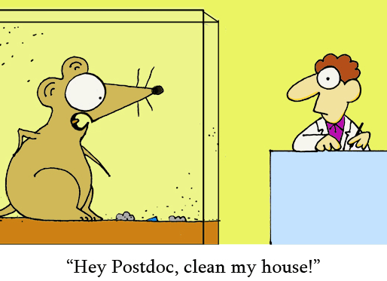
Materials: procedure
Each step taken from beginning to end to perform your research:
  Research Proposal: Provides details of what you anticipate will happen during the research process in chronological order (in future verb tense)
  Final Paper: Changes to what actually happened (in past verb tense)
  Location
  Recruiting procedures
  Time to take surveys
  How tests or measurements are administered
  Single-blind vs. double-blind
  Debriefing
  When/how incentives, if any, were given

Slide 25
statistics in proposal/Results in Final paper
How do you know what stats you will use for your hypothesis?
  Number of variables (i.e., Ivs and DVs)
  Kinds of variables
    Categorical
    Continuous
  This will be given to you in your Research Project Approval Form
In Research Proposal Papers it is the Statistics section
  Explain that descriptive statistics will be performed to describe demographics and scale measurements.
  Then give the statistics (e.g., t-Test, ANOVA) you will use to test your hypothesis.
    Example: To evaluate the different between strong and weak study skills on exam scores, a t-Test will be used to explore any significant differences between group means.
This section becomes the Results section Final Research Papers
  Final research statistical results are reported
  See Reporting Statistics in Psychology cheat sheet to report results in accurate APA format based upon statistical test used.

Slide 26
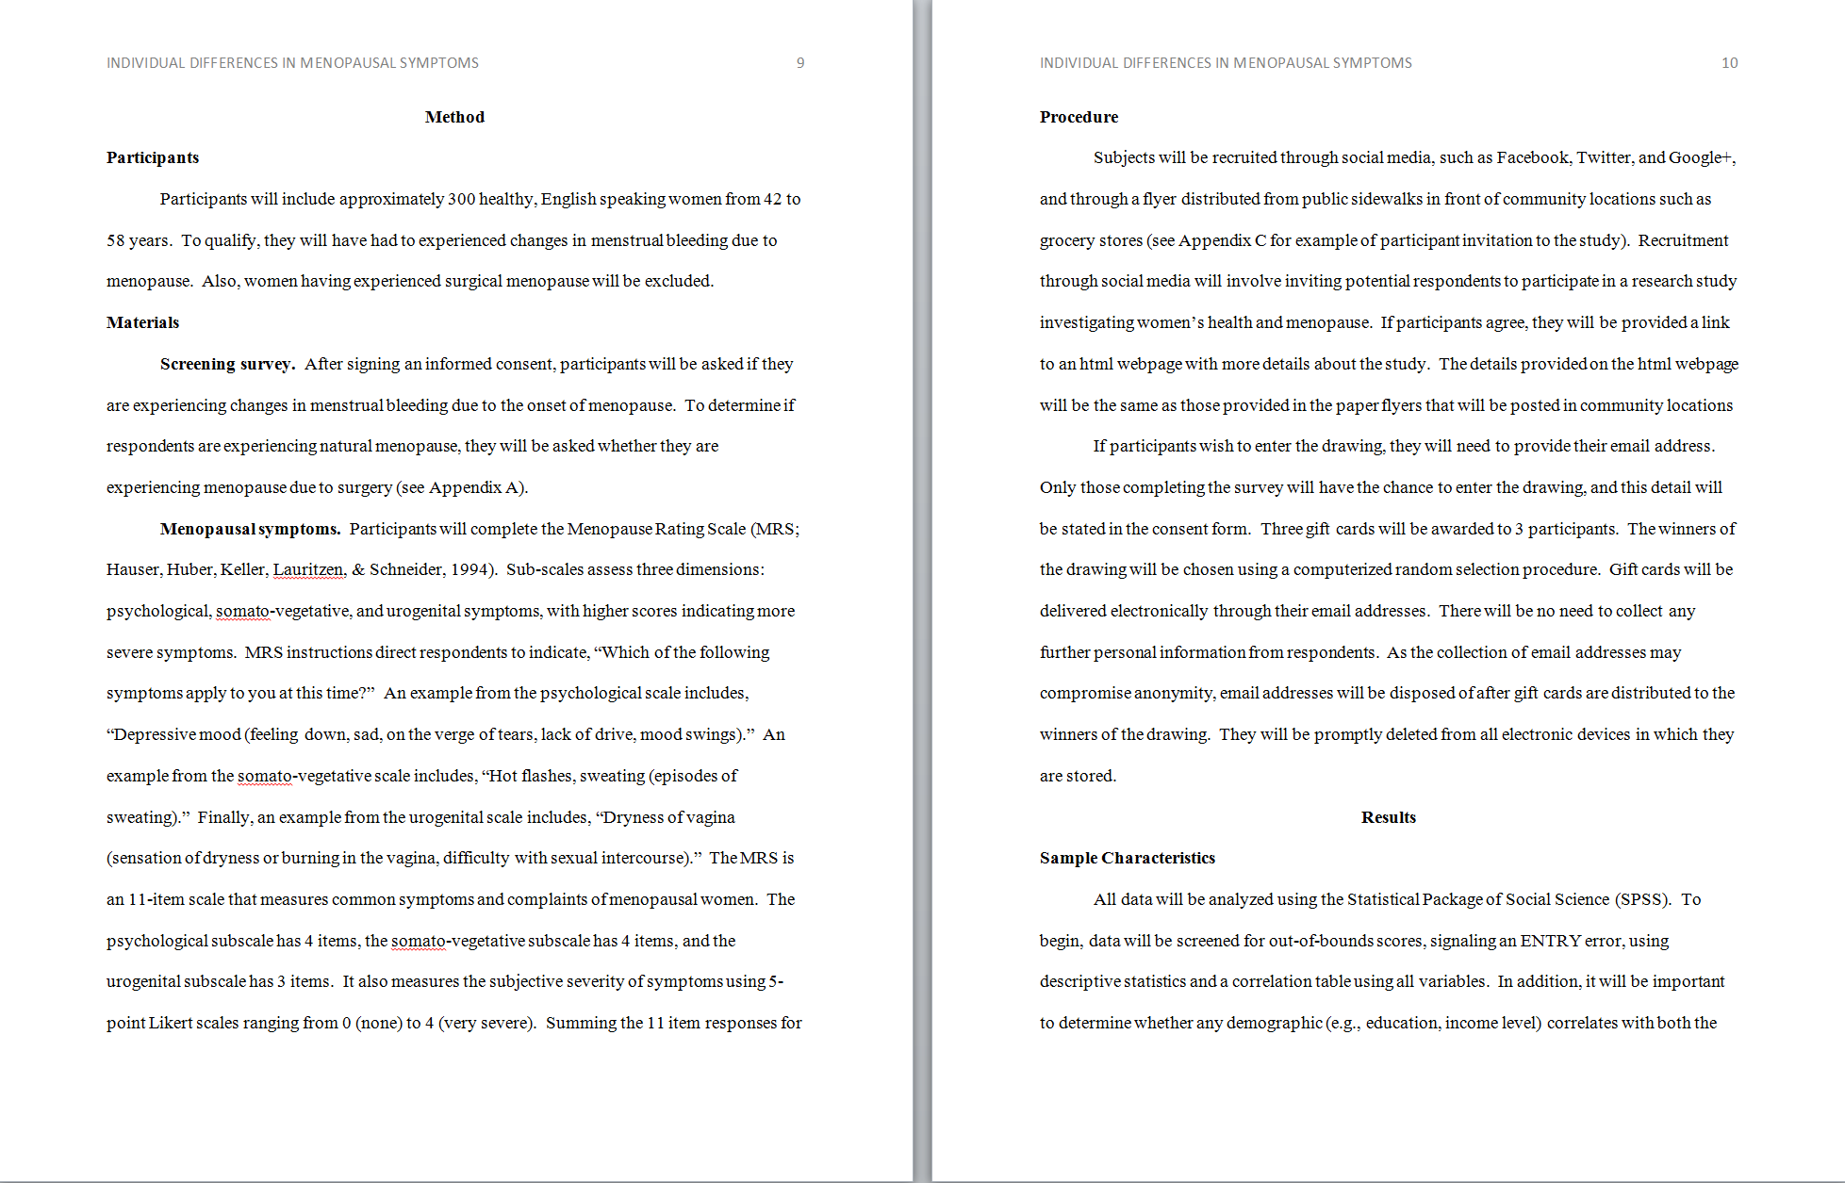
DO NOT start the Method section on a new page!
Level 1 Heading
Level 2 Heading
Notice the placement and formatting of all (sub)headings.
Level 3 Heading
Statistics section in Research Proposals. Changed to Results in Final Research Papers. DO NOT start this section on a new page.
Level 1 Heading

Slide 27
Possible outcomes (Becomes Discussion section in final paper)
RESEARCH PROPOSAL PAPER: Provide possible weaknesses and strengths associated with your proposed study.
  Think of some of the advantages and disadvantages that we've covered for different types of study designs and sampling techniques and discuss them here.
Some Possible Outcomes
  hypothesis is supported
  hypothesis is not supported
  Give some reasons why each might happen, state the implications associated with both possible scenarios, and offer alternative explanations in the event your hypothesis is not supported.
Discusses possible results relative to the other research discussed in your introduction section
FINAL RESEARCH PAPER: change this to the Discussion section and change the possible outcomes to the actual outcomes you obtained, as well as the possible weaknesses to the actual weaknesses that occurred.

Slide 28
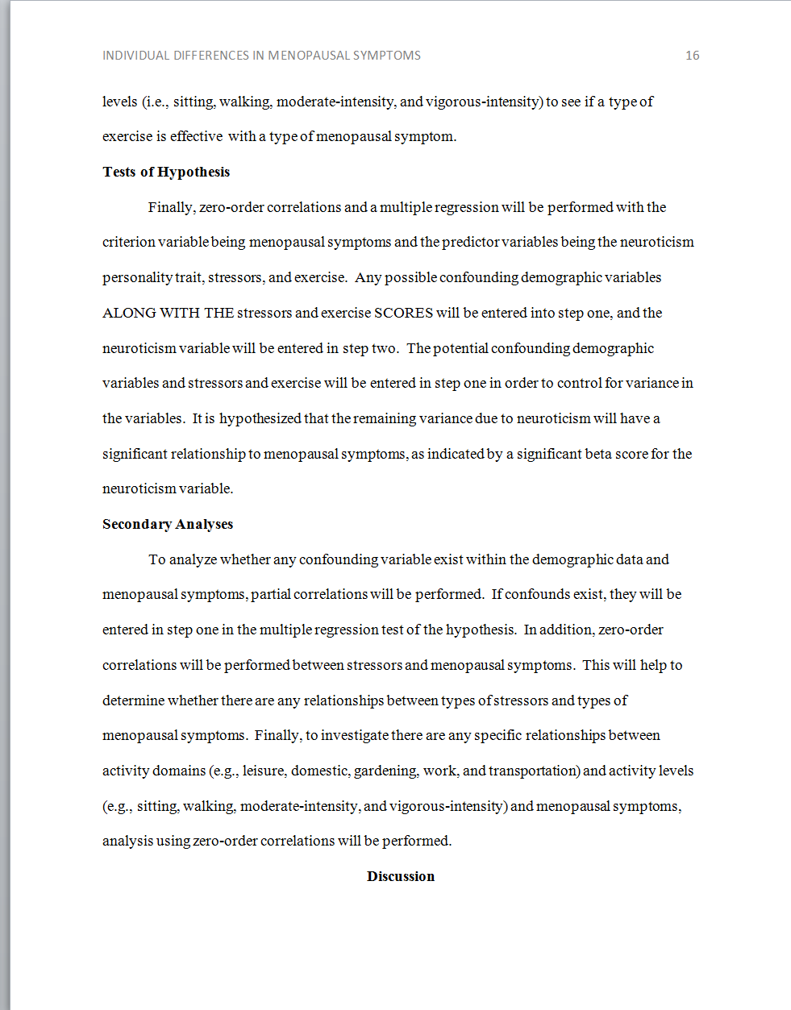
Possible Outcomes in Research Proposals. Changed to Discussion in Final Research Papers.
Include a subtitle even if it is at the end of a page. DO NOT start on the next page.

Slide 29
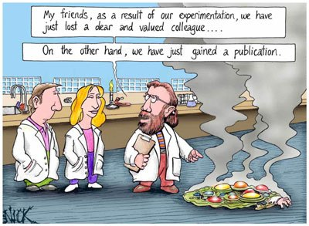
references
Alphabetical Order
Hanging indent
Starts on new page
Title, “References,” is centered
Double spaced, 1-inch margins
Stroop paper: your one and only source is provided for you on the class website
Research Proposals Papers #2A/Final Research Papers #2B: You should have at least 3 peer reviewed articles, preferably found through the OCC library, and 1 alternative resource (i.e., a News Resource or Alternative Resource such as a .gov, .org, .com, etc. The class website Sources webpage provides a great place to start)

Slide 30
References Cont.
Journal format:
  Last, F. M., & Last, F. M. (Year Published). Article title. Journal Name, Volume(Issue), pp. Pages.
  Ex: Fearon, J. D., & Laitin, D. D. (2003). Ethnicity, Insurgency, and Civil War. American Political Science Review, 97(01), 75-85. https://doi:10.1017/S0003055403000534
Website format:
  Last, F. M. (Year, Month Date Published). Article title. Retrieved from URL
  Ex: Satalkar, B. (2010, July 15). Water aerobics. Retrieved from http://www.buzzle.com
  Cain, K. (2012, June 29). The Negative effects of Facebook on communication. Social Media Today RSS. https://socialmediatoday.com
Book format:
  Last, F. M. (Year Published) Book. City, State: Publisher.
Chapter from book:
  Last, F. M. (Year Published). Title of chapter In F. M. Last Editor (Ed.), Title of book/anthology (pp. Pages). Publisher City, State: Publisher.
Dictionary:
  Dictionary Title, # ed., s.v. "entry name.“
  Ex: Merriam-Webster Dictionary, 3rd ed., s.v. "donkey."

Slide 31
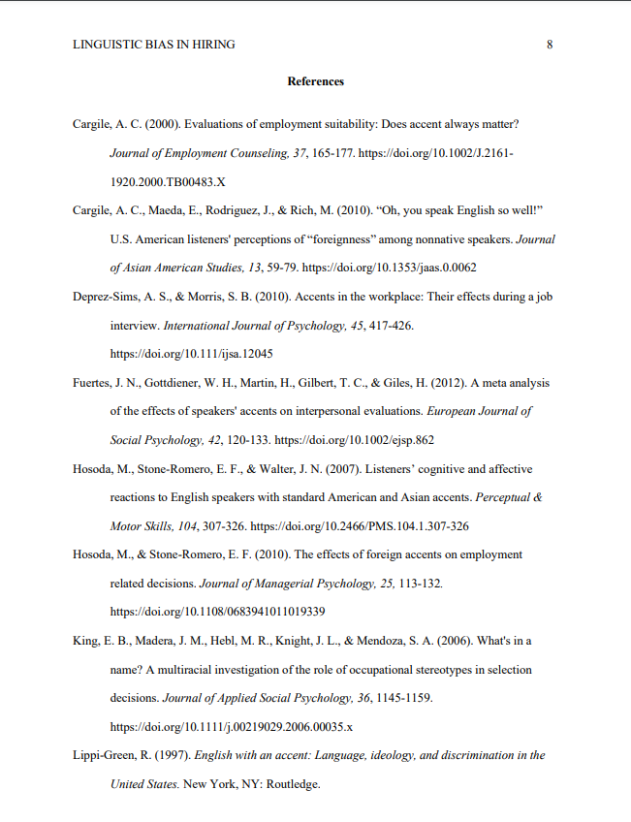
DO start the References section on a new page!
Use sentence case for article titles: Only the first letter, a proper noun, or a word after a colon in an article’s title should be capitalized in article titles.
Hanging indents
Include doi (digital object identifiers).
Can usually be found on the articles, by Googling them, or in library database.
Italicize Journal titles and volume numbers. Do not italicize issue numbers.
Alphabetical order
Use title case for journal titles.
Don’t forget page numbers.
Use full last names and abbreviate first/middle names.
Pay careful attention to placement of punctuation.

Slide 32
Learning Check #7
Which is the correct APA 7th format for a book?
Cole, K 2019, Leadership and management: theory and practice, 7th ed, Cengage, South Melbourne: VIC.
Cole, K. (2019). Leadership and management: Theory and practice (7th ed.). Cengage.
Cole, K, (2019), Leadership and management: Theory and practice (7th Ed.), South Melbourne, VIC: Cengage.

Slide 33
Learning Check #8
Which is the correct APA 7th format for an ejournal article?
Spurlock, D. (2019). Toward an inclusive vision of both nursing practice and nursing science. Journal of Nursing Education, 58(6), 319-320. https://doi.org/10.3928/01484834-20190521-01
Spurlock, D 2019, Toward an inclusive vision of both nursing practice and nursing science. Journal of Nursing Education, vol. 58, no. 6, pp. 319-320. Retrieved from ProQuest.
Spurlock, D, (2019), Toward an inclusive vision of both nursing practice and nursing science, Journal of Nursing Education, 58(6), pp. 319-320. doi: 10.3928/01484834-20190521-01.

